Slide 1
Chapter 10
Functional Dependencies and Normalization for Relational Databases
Copyright © 2007 Ramez Elmasri and Shamkant B. Navathe

Slide 2
Chapter Outline
1 Informal Design Guidelines for Relational Databases
  1.1Semantics of the Relation Attributes
  1.2 Redundant Information in Tuples and Update Anomalies
2 Functional Dependencies (FDs)
  2.1 Definition of FD
  2.2 Inference Rules for FDs
3 Normal Forms Based on Primary Keys
  3.1 Normalization of Relations
  3.2 Practical Use of Normal Forms
  3.3 Definitions of Keys and Attributes Participating in Keys
  3.4 First Normal Form
  3.5 Second Normal Form
  3.6 Third Normal Form
Slide 10- <number>

Slide 3
Introduction
In Chapters 3 through 6, we presented various aspects of the relational model and the languages associated with it. Each relation schema consists of a number of attributes, and the relational database schema consists of a number of relation schemas.
So far, we have assumed that attributes are grouped to form a relation schema by using the common sense of the database designer or by mapping a database schema design from a conceptual data model such as the ER data model.
However, we still need some formal way of analyzing why one grouping of attributes into a relation schema may be better than another.
Slide 10- <number>

Slide 4
1 Informal Design Guidelines for Relational Databases (1)
What is relational database design?
  The grouping of attributes to form "good" relation schemas
Two levels of relation schemas
  The logical "user view" level
  The storage "base relation" level
Design is concerned mainly with base relations
What are the criteria for "good" base relations?
Slide 10- <number>

Slide 5
1.1 Semantics of the Relation Attributes
GUIDELINE 1: Informally, each tuple in a relation should represent one entity or relationship instance. (Applies to individual relations and their attributes).
  Attributes of different entities (EMPLOYEEs, DEPARTMENTs, PROJECTs) should not be mixed in the same relation
  Only foreign keys should be used to refer to other entities
  Entity and relationship attributes should be kept apart as much as possible.
Bottom Line: Design a schema that can be explained easily relation by relation. The semantics of attributes should be easy to interpret.
Slide 10- <number>

Slide 6
Guideline to Redundant Information in Tuples and Update Anomalies
GUIDELINE 2:
  Design a schema that does not suffer from the insertion, deletion and update anomalies.
  If there are any anomalies present, then note them so that applications can be made to take them into account.
Slide 10- <number>

Slide 7
1.3 Null Values in Tuples
GUIDELINE 3:
  Relations should be designed such that their tuples will have as few NULL values as possible
  Attributes that are NULL frequently could be placed in separate relations (with the primary key)
Slide 10- <number>

Slide 8
1.2 Redundant Information in Tuples and Update Anomalies
Information is stored redundantly
  Wastes storage
  Causes problems with update anomalies
    Insertion anomalies
    Deletion anomalies
    Modification anomalies
Slide 10- <number>

Slide 9
EXAMPLE OF AN UPDATE ANOMALY
Consider the relation:
  EMP_PROJ(Emp#, Proj#, Ename, Pname, No_hours)
Update Anomaly:
  Changing the name of project number P1 from “Billing” to “Customer-Accounting” may cause this update to be made for all 100 employees working on project P1.
Slide 10- <number>

Slide 10
EXAMPLE OF AN INSERT ANOMALY
Consider the relation:
  EMP_PROJ(Emp#, Proj#, Ename, Pname, No_hours)
Insert Anomaly:
  Cannot insert a project unless an employee is assigned to it.
Conversely
  Cannot insert an employee unless an he/she is assigned to a project.
Slide 10- <number>

Slide 11
EXAMPLE OF AN DELETE ANOMALY
Consider the relation:
  EMP_PROJ(Emp#, Proj#, Ename, Pname, No_hours)
Delete Anomaly:
  When a project is deleted, it will result in deleting all the employees who work on that project.
  Alternately, if an employee is the sole employee on a project, deleting that employee would result in deleting the corresponding project.
Slide 10- <number>

Slide 12
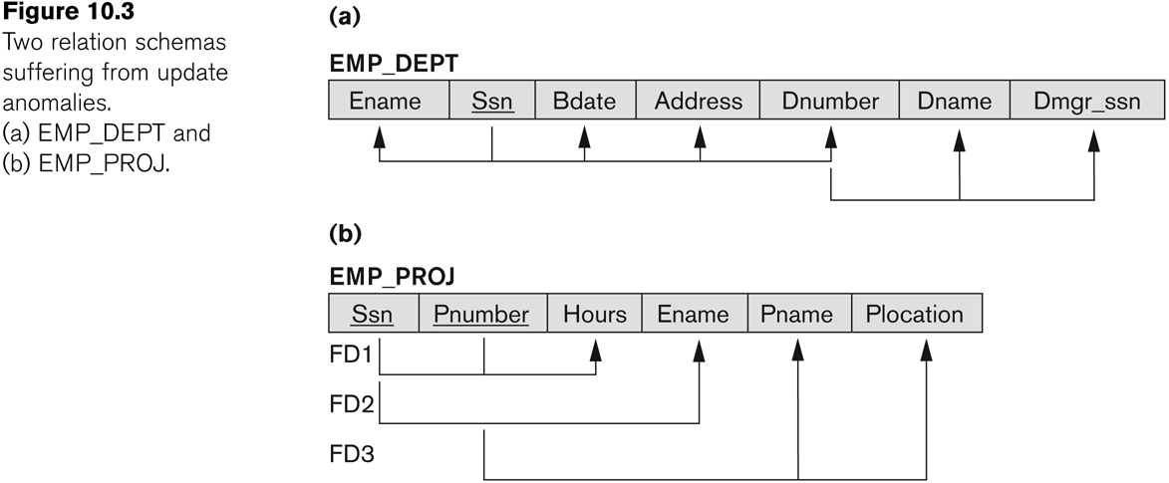
Figure 10.3 Two relation schemas suffering from update anomalies
Slide 10- <number>

Slide 13
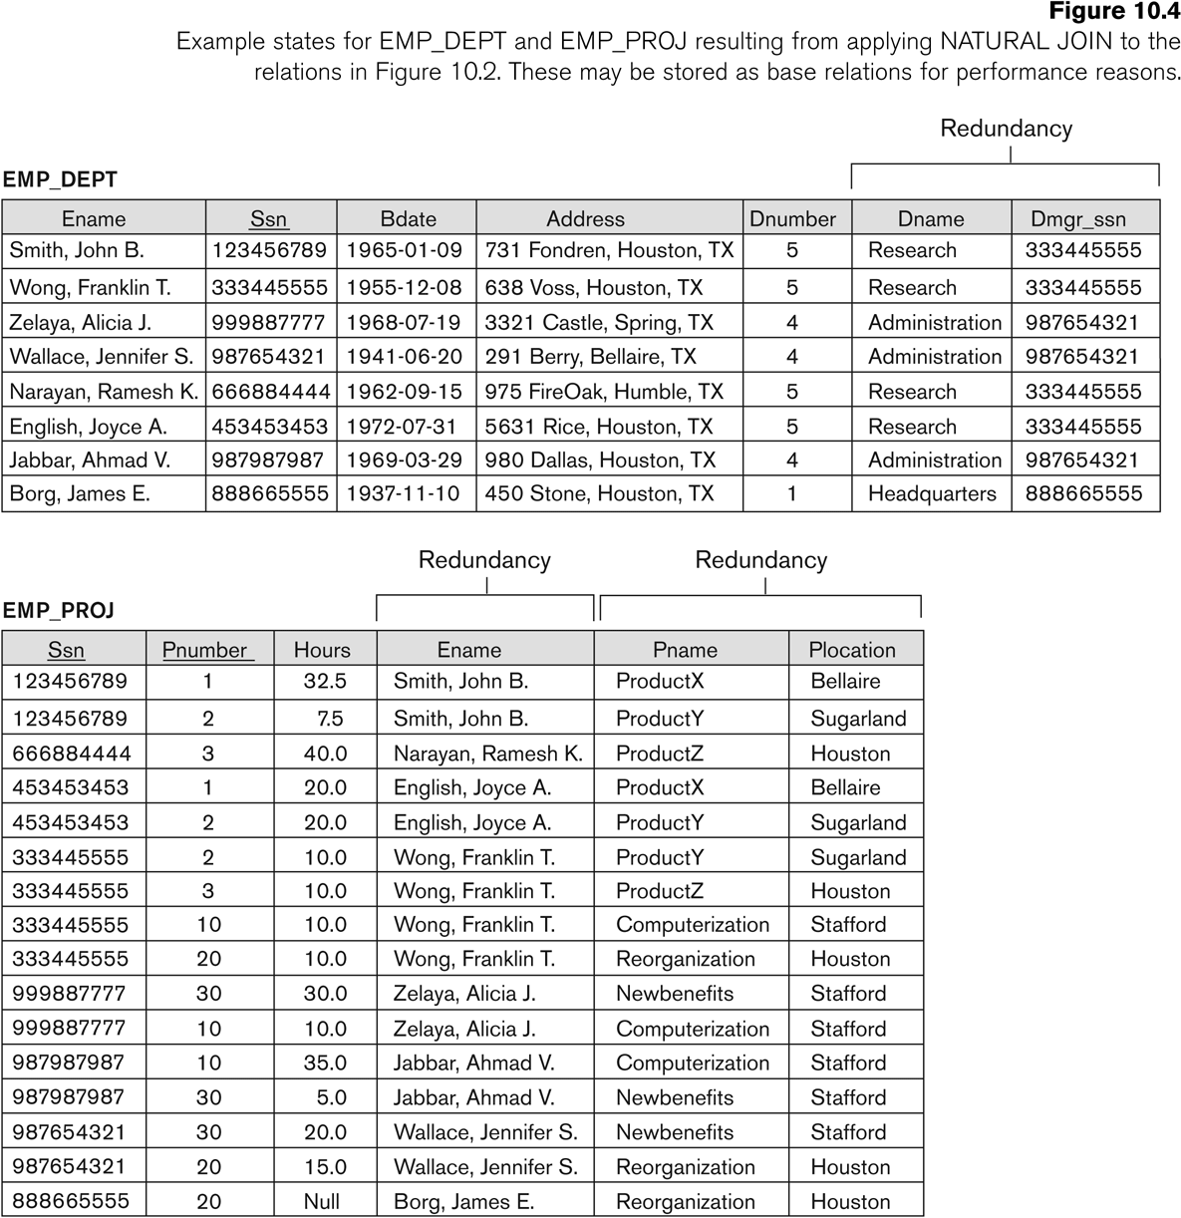
Figure 10.4 Example States for EMP_DEPT and EMP_PROJ
Slide 10- <number>

Slide 14
2.1 Functional Dependencies (1)
Functional dependencies (FDs)
  Are used to specify formal measures of the "goodness" of relational designs
  And keys are used to define normal forms for relations
  Are constraints that are derived from the meaning and interrelationships of the data attributes
A set of attributes X functionally determines a set of attributes Y if the value of X determines a unique value for Y
Slide 10- <number>

Slide 15
Functional Dependencies (2)
X -> Y holds if whenever two tuples have the same value for X, they must have the same value for Y
  For any two tuples t1 and t2 in any relation instance r(R): If t1[X]=t2[X], then t1[Y]=t2[Y]
X -> Y in R specifies a constraint on all relation instances r(R)
Written as X -> Y; can be displayed graphically on a relation schema as in Figures. ( denoted by the arrow: ).
FDs are derived from the real-world constraints on the attributes
Slide 10- <number>

Slide 16
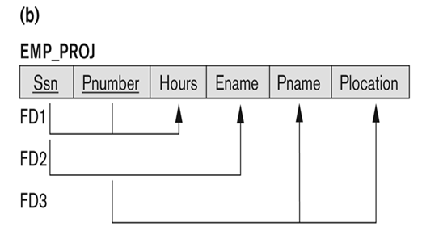
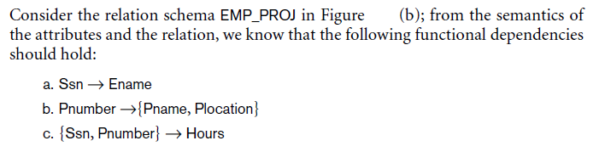
FD Example
Slide 10- <number>

Slide 17
Examples of FD constraints (1)
Social security number determines employee name
  SSN -> ENAME
Project number determines project name and location
  PNUMBER -> {PNAME, PLOCATION}
Employee ssn and project number determines the hours per week that the employee works on the project
  {SSN, PNUMBER} -> HOURS
Slide 10- <number>

Slide 18
Examples of FD constraints (2)
An FD is a property of the attributes in the schema R
The constraint must hold on every relation instance r(R)
If K is a key of R, then K functionally determines all attributes in R
  (since we never have two distinct tuples with t1[K]=t2[K])
Slide 10- <number>
Notes:
Section 2

Slide 19
2.2 Inference Rules for FDs (1)
Given a set of FDs F, we can infer additional FDs that hold whenever the FDs in F hold
Armstrong's inference rules:
  IR1. (Reflexive) If Y subset-of X, then X -> Y
  IR2. (Augmentation) If X -> Y, then XZ -> YZ
    (Notation: XZ stands for X U Z)
  IR3. (Transitive) If X -> Y and Y -> Z, then X -> Z
IR1, IR2, IR3 form a sound and complete set of inference rules
  These are rules hold and all other rules that hold can be deduced from these
Slide 10- <number>

Slide 20
Inference Rules for FDs (2)
Some additional inference rules that are useful:
  Decomposition: If X -> YZ, then X -> Y and X -> Z
  Union: If X -> Y and X -> Z, then X -> YZ
  Psuedotransitivity: If X -> Y and WY -> Z, then WX -> Z
The last three inference rules, as well as any other inference rules, can be deduced from IR1, IR2, and IR3 (completeness property)
Slide 10- <number>

Slide 21
3.1 Normalization of Relations (1)
The normalization process, as first proposed by Codd (1972a), takes a relation schema through a series of tests to certify whether it satisfies a certain normal form.
The process, which proceeds in a top-down fashion by evaluating each relation against the criteria for normal forms and decomposing relations as necessary, can thus be considered as relational design by analysis.
Normalization:
  The process of decomposing unsatisfactory "bad" relations by breaking up their attributes into smaller relations
Normal form:
  Condition using keys and FDs of a relation to certify whether a relation schema is in a particular normal form.
2NF and 3NF
  based on keys and FDs of a relation schema
Slide 10- <number>

Slide 22
3.2 Practical Use of Normal Forms
Normalization is carried out in practice so that the resulting designs are of high quality and meet the desirable properties
The practical utility of these normal forms becomes questionable when the constraints on which they are based are hard to understand or to detect
The database designers need not normalize to the highest possible normal form
  (usually up to 3NF, BCNF or 4NF)
Denormalization:
  The process of storing the join of higher normal form relations as a base relation—which is in a lower normal form
Slide 10- <number>

Slide 23
3.3 Definitions of Keys and Attributes Participating in Keys (1)
A superkey of a relation schema R = {A1, A2, ...., An} is a set of attributes S subset-of R with the property that no two tuples t1 and t2 in any legal relation state r of R will have t1[S] = t2[S]
A key K is a superkey with the additional property that removal of any attribute from K will cause K not to be a superkey any more.
Slide 10- <number>

Slide 24
Definitions of Keys and Attributes Participating in Keys (2)
If a relation schema has more than one key, each is called a candidate key.
  One of the candidate keys is arbitrarily designated to be the primary key, and the others are called secondary keys.
A Prime attribute must be a member of some candidate key
A Nonprime attribute is not a prime attribute—that is, it is not a member of any candidate key.
Slide 10- <number>

Slide 25
3.2 First Normal Form
Disallows
  composite attributes
  multivalued attributes
  nested relations; attributes whose values for an individual tuple are non-atomic
Considered to be part of the definition of relation
Slide 10- <number>

Slide 26

Figure 10.8 Normalization into 1NF
Slide 10- <number>

Slide 27
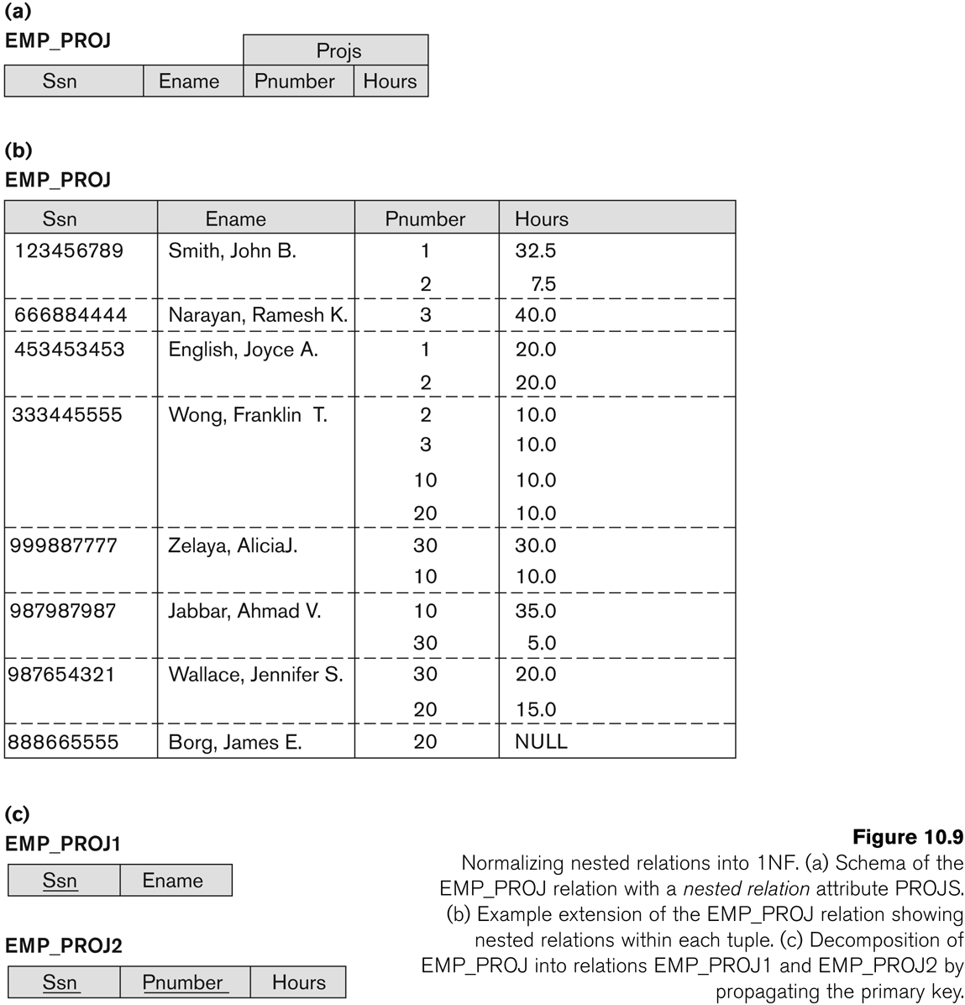
Figure 10.9 Normalization nested relations into 1NF
Slide 10- <number>

Slide 28
3.3 Second Normal Form (1)
Uses the concepts of FDs, primary key
Definitions
  Prime attribute: An attribute that is member of the primary key K
  Full functional dependency: a FD Y -> Z where removal of any attribute from Y means the FD does not hold any more
Examples:
  {SSN, PNUMBER} -> HOURS is a full FD since neither SSN -> HOURS nor PNUMBER -> HOURS hold
  {SSN, PNUMBER} -> ENAME is not a full FD (it is called a partial dependency ) since SSN -> ENAME also holds
Slide 10- <number>

Slide 29
Second Normal Form (2)
A relation schema R is in second normal form (2NF) if every non-prime attribute A in R is fully functionally dependent on the primary key
R can be decomposed into 2NF relations via the process of 2NF normalization
Slide 10- <number>

Slide 30
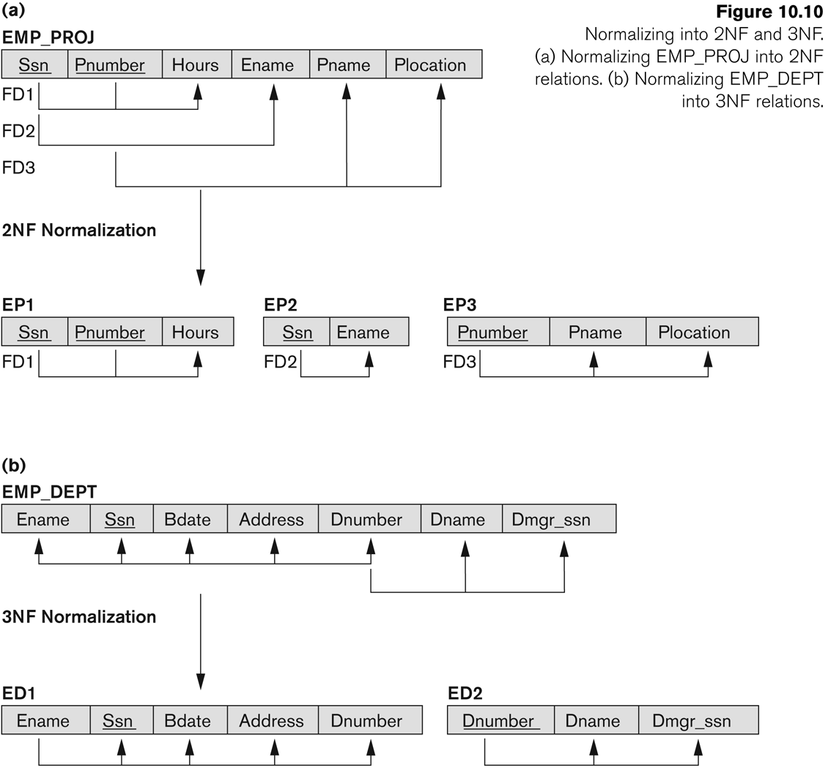
Figure 10.10 Normalizing into 2NF and 3NF
Slide 10- <number>

Slide 31
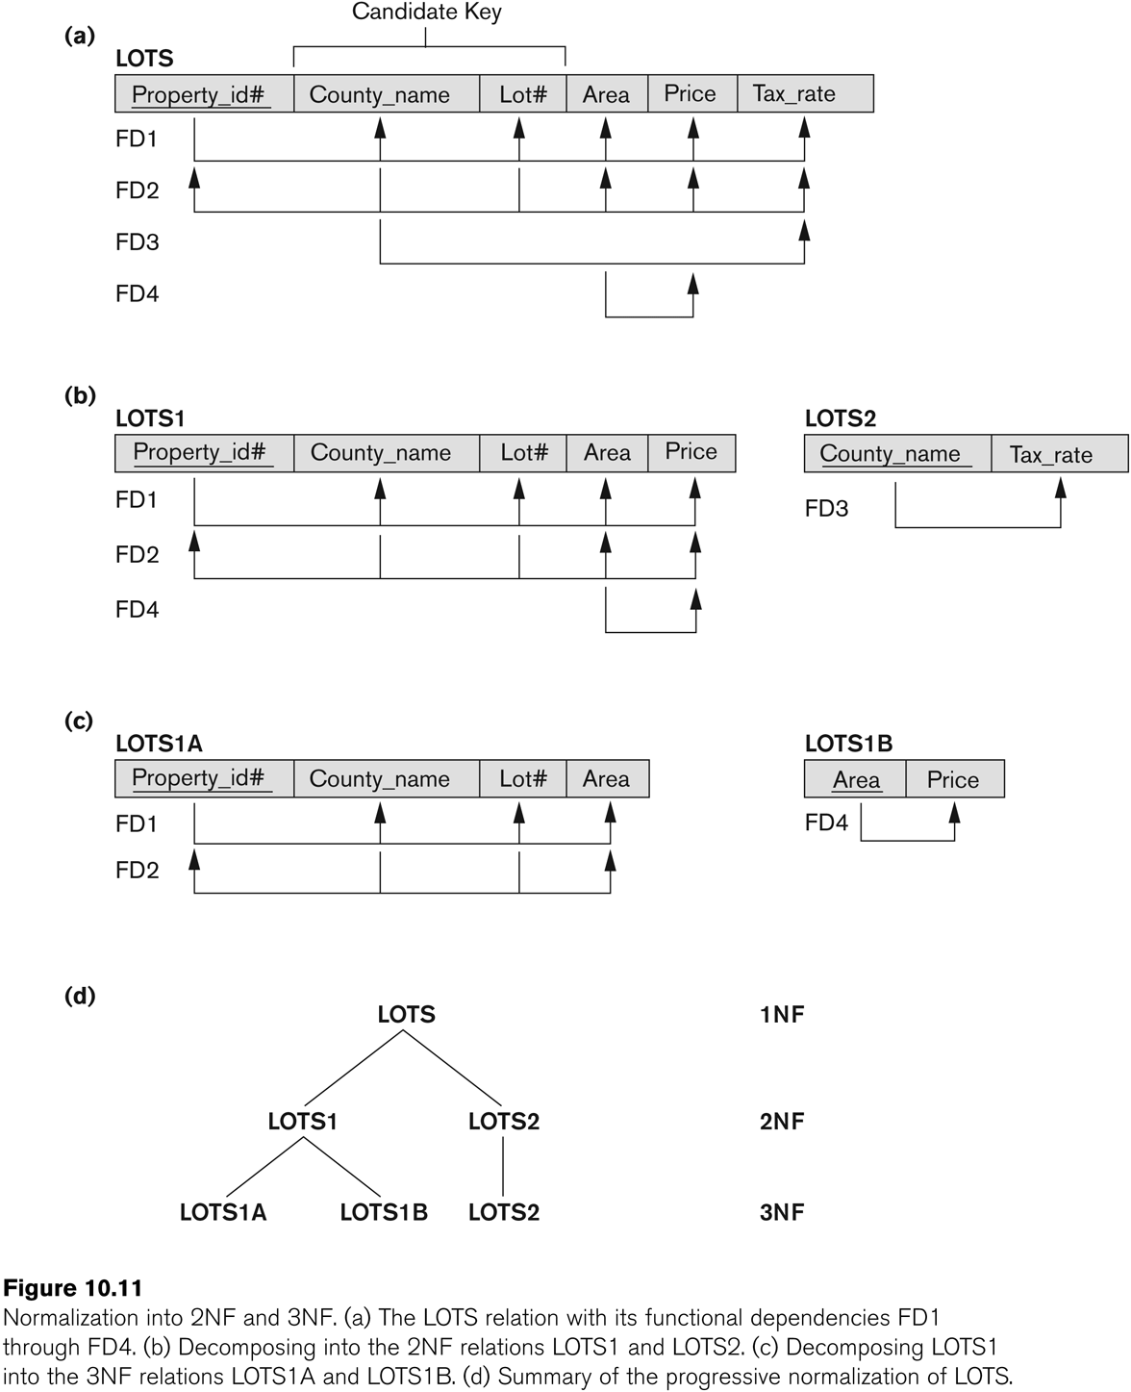
Figure 10.11 Normalization into 2NF and 3NF
Slide 10- <number>

Slide 32
3.4 Third Normal Form (1)
Definition:
  Transitive functional dependency: a FD X -> Z that can be derived from two FDs X -> Y and Y -> Z
Examples:
  SSN -> DMGRSSN is a transitive FD
    Since SSN -> DNUMBER and DNUMBER -> DMGRSSN hold
  SSN -> ENAME is non-transitive
    Since there is no set of attributes X where SSN -> X and X -> ENAME
Slide 10- <number>

Slide 33
Third Normal Form (2)
A relation schema R is in third normal form (3NF) if it is in 2NF and no non-prime attribute A in R is transitively dependent on the primary key
R can be decomposed into 3NF relations via the process of 3NF normalization
NOTE:
  In X -> Y and Y -> Z, with X as the primary key, we consider this a problem only if Y is not a candidate key.
  When Y is a candidate key, there is no problem with the transitive dependency .
  E.g., Consider EMP (SSN, Emp#, Salary ).
    Here, SSN -> Emp# -> Salary and Emp# is a candidate key.
Slide 10- <number>

